Slide 1

ESP32-Based Portable Thermal Monitoring & Imaging System
Yatin – SE22UECE007
Anshul – SE22UECM013
Siddharth – SE22UECM016

Slide 2

Introduction:
ESP32-Based Portable Thermal Monitoring & Imaging System
Thermal imaging enables non-contact temperature monitoring
Widely used in healthcare, security, and industrial inspection
Commercial thermal cameras are expensive and limited in accessibility
Low-cost and portable thermal imaging solutions are still scarce

Slide 3
Objectives:
To design a low-cost and portable thermal monitoring system
To capture real-time temperature data using an infrared thermal sensor
To process thermal data using an ESP32-based embedded platform
To visualize temperature variations as a color-based heatmap
To demonstrate an affordable alternative to conventional thermal cameras

Slide 4

System Overview:
Thermal data is captured from the surrounding environment
An infrared sensor detects temperature variations
ESP32 processes the data in real time
A TFT display visualizes the output as a heatmap

Slide 5

Hardware Components Used:
1. ESP32 (Bharat Pi) The ESP32 acts as the main controller, processing thermal sensor data and driving the TFT display for real-time visualization.
2. AMG8833 Infrared Thermal Sensor The AMG8833 measures non-contact temperature data in an 8×8 grid and provides real-time thermal readings to the ESP32.
3. 1.8-inch TFT Display The TFT display visualizes processed thermal data as a colour-based heatmap for easy interpretation.

Slide 6
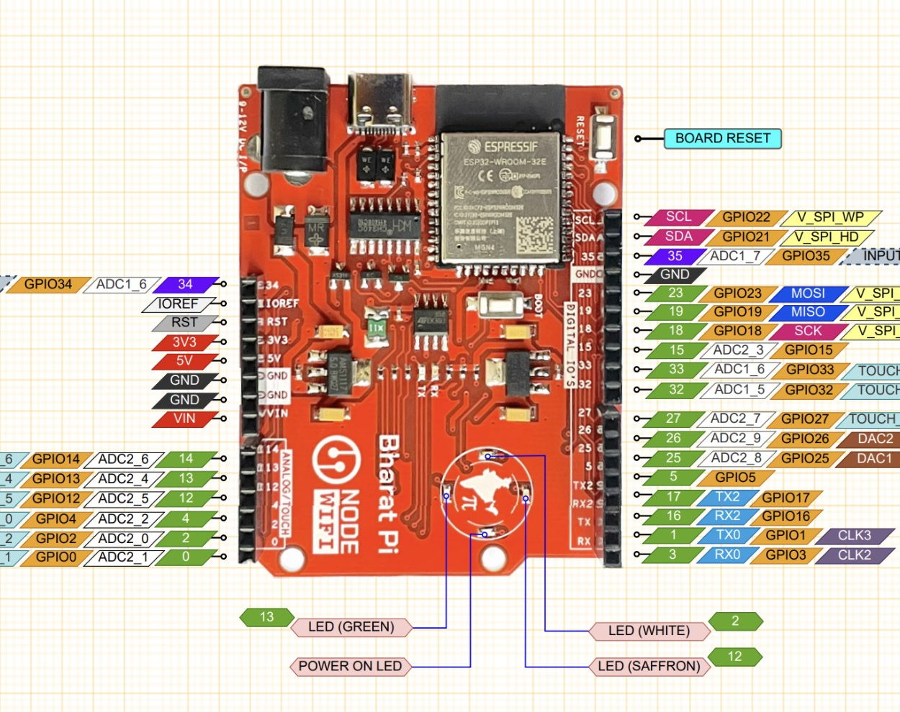
ESP32 (Bharat Pi):

Slide 7
Working Principle:
The thermal sensor measures temperature without physical contact
ESP32 reads sensor data using the I²C protocol
Temperature values are processed and scaled
A color-based heatmap is generated and displayed

Slide 8
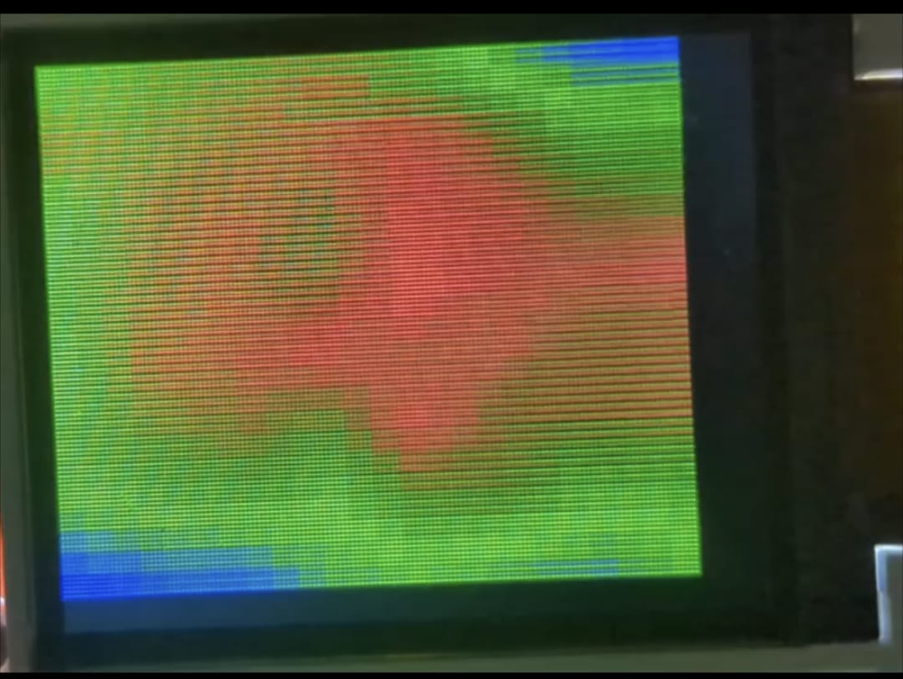
Software Implementation:
Required libraries are included to handle I²C communication, SPI communication, graphics rendering, and thermal sensor interfacing
Pin definitions are set to interface the ESP32 with the TFT display and thermal sensor
The ESP32 initializes the TFT display and AMG8833 sensor during the setup phase
Thermal pixel data is continuously read from the AMG8833 sensor
Minimum and maximum temperature values are dynamically calculated for each frame
Bilinear interpolation is applied to smooth the low-resolution thermal data
Temperature values are mapped to a color gradient ranging from blue (cool) to red (hot)
The processed thermal image is rendered in real time on the TFT display

Slide 9
Temperature Mapping & Visualization:
Each pixel represents an individual temperature value
Cooler regions appear in blue shades
Warmer regions appear in red shades
Gradual colour transitions indicate temperature differences

Slide 10

Results & Observations:
Real-time thermal visualization achieved
Clear identification of heat sources
Smooth and stable display output
Portable and low-cost design validated

Slide 11

Applications & Limitations:
Applications
Temperature monitoring
Human presence detection
Educational demonstrations
Limitations
Low spatial resolution due to 8 × 8 sensor
Limited accuracy compared to commercial systems

Slide 12
Conclusion & Future Scope:
A compact thermal monitoring system was successfully developed
Demonstrates effective use of embedded systems
Affordable alternative to commercial thermal cameras
Future improvements include higher-resolution sensors and wireless visualization

